Slide 1



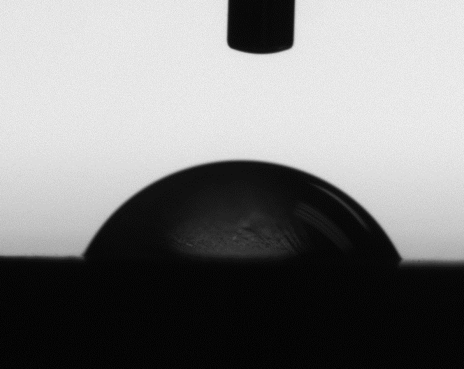
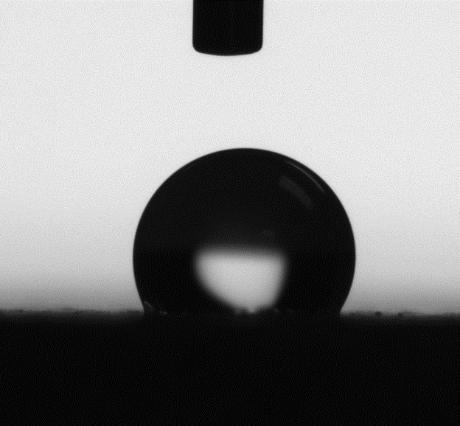
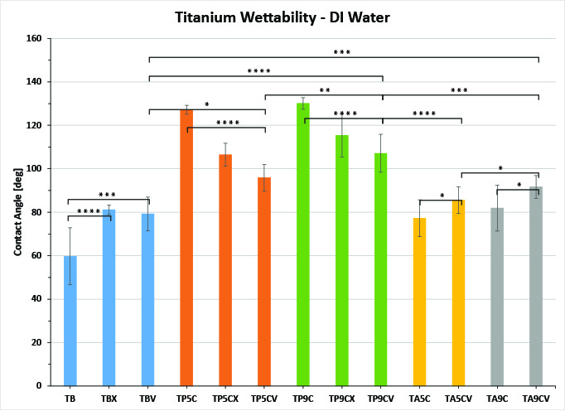
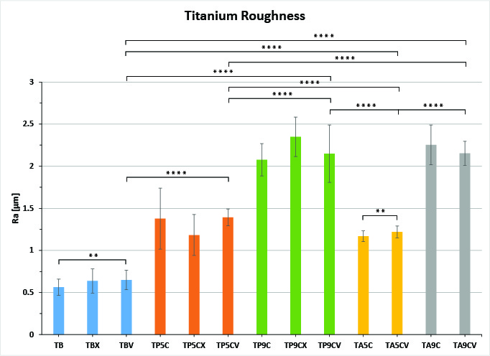

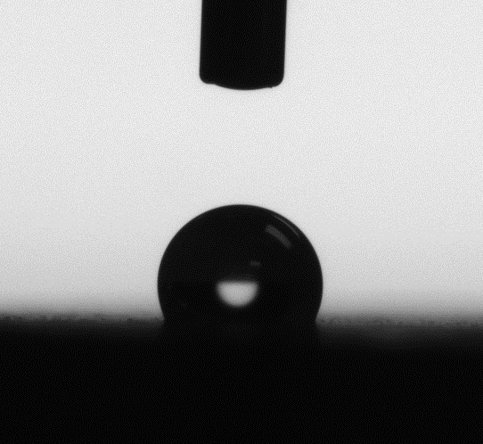
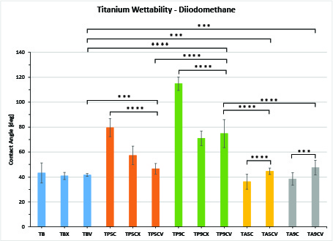
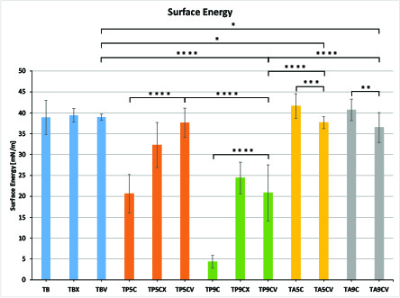
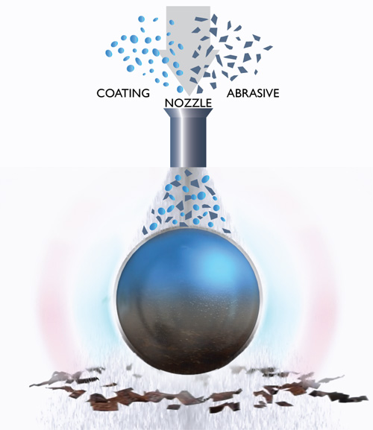
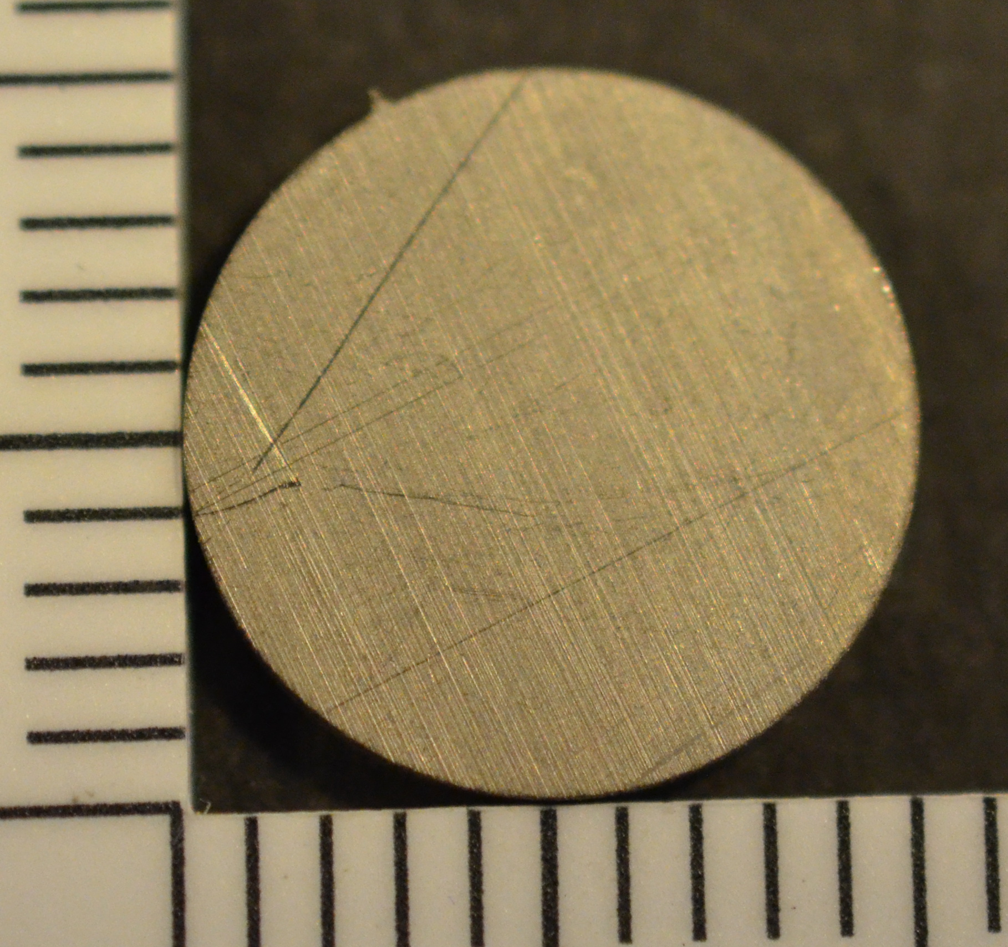
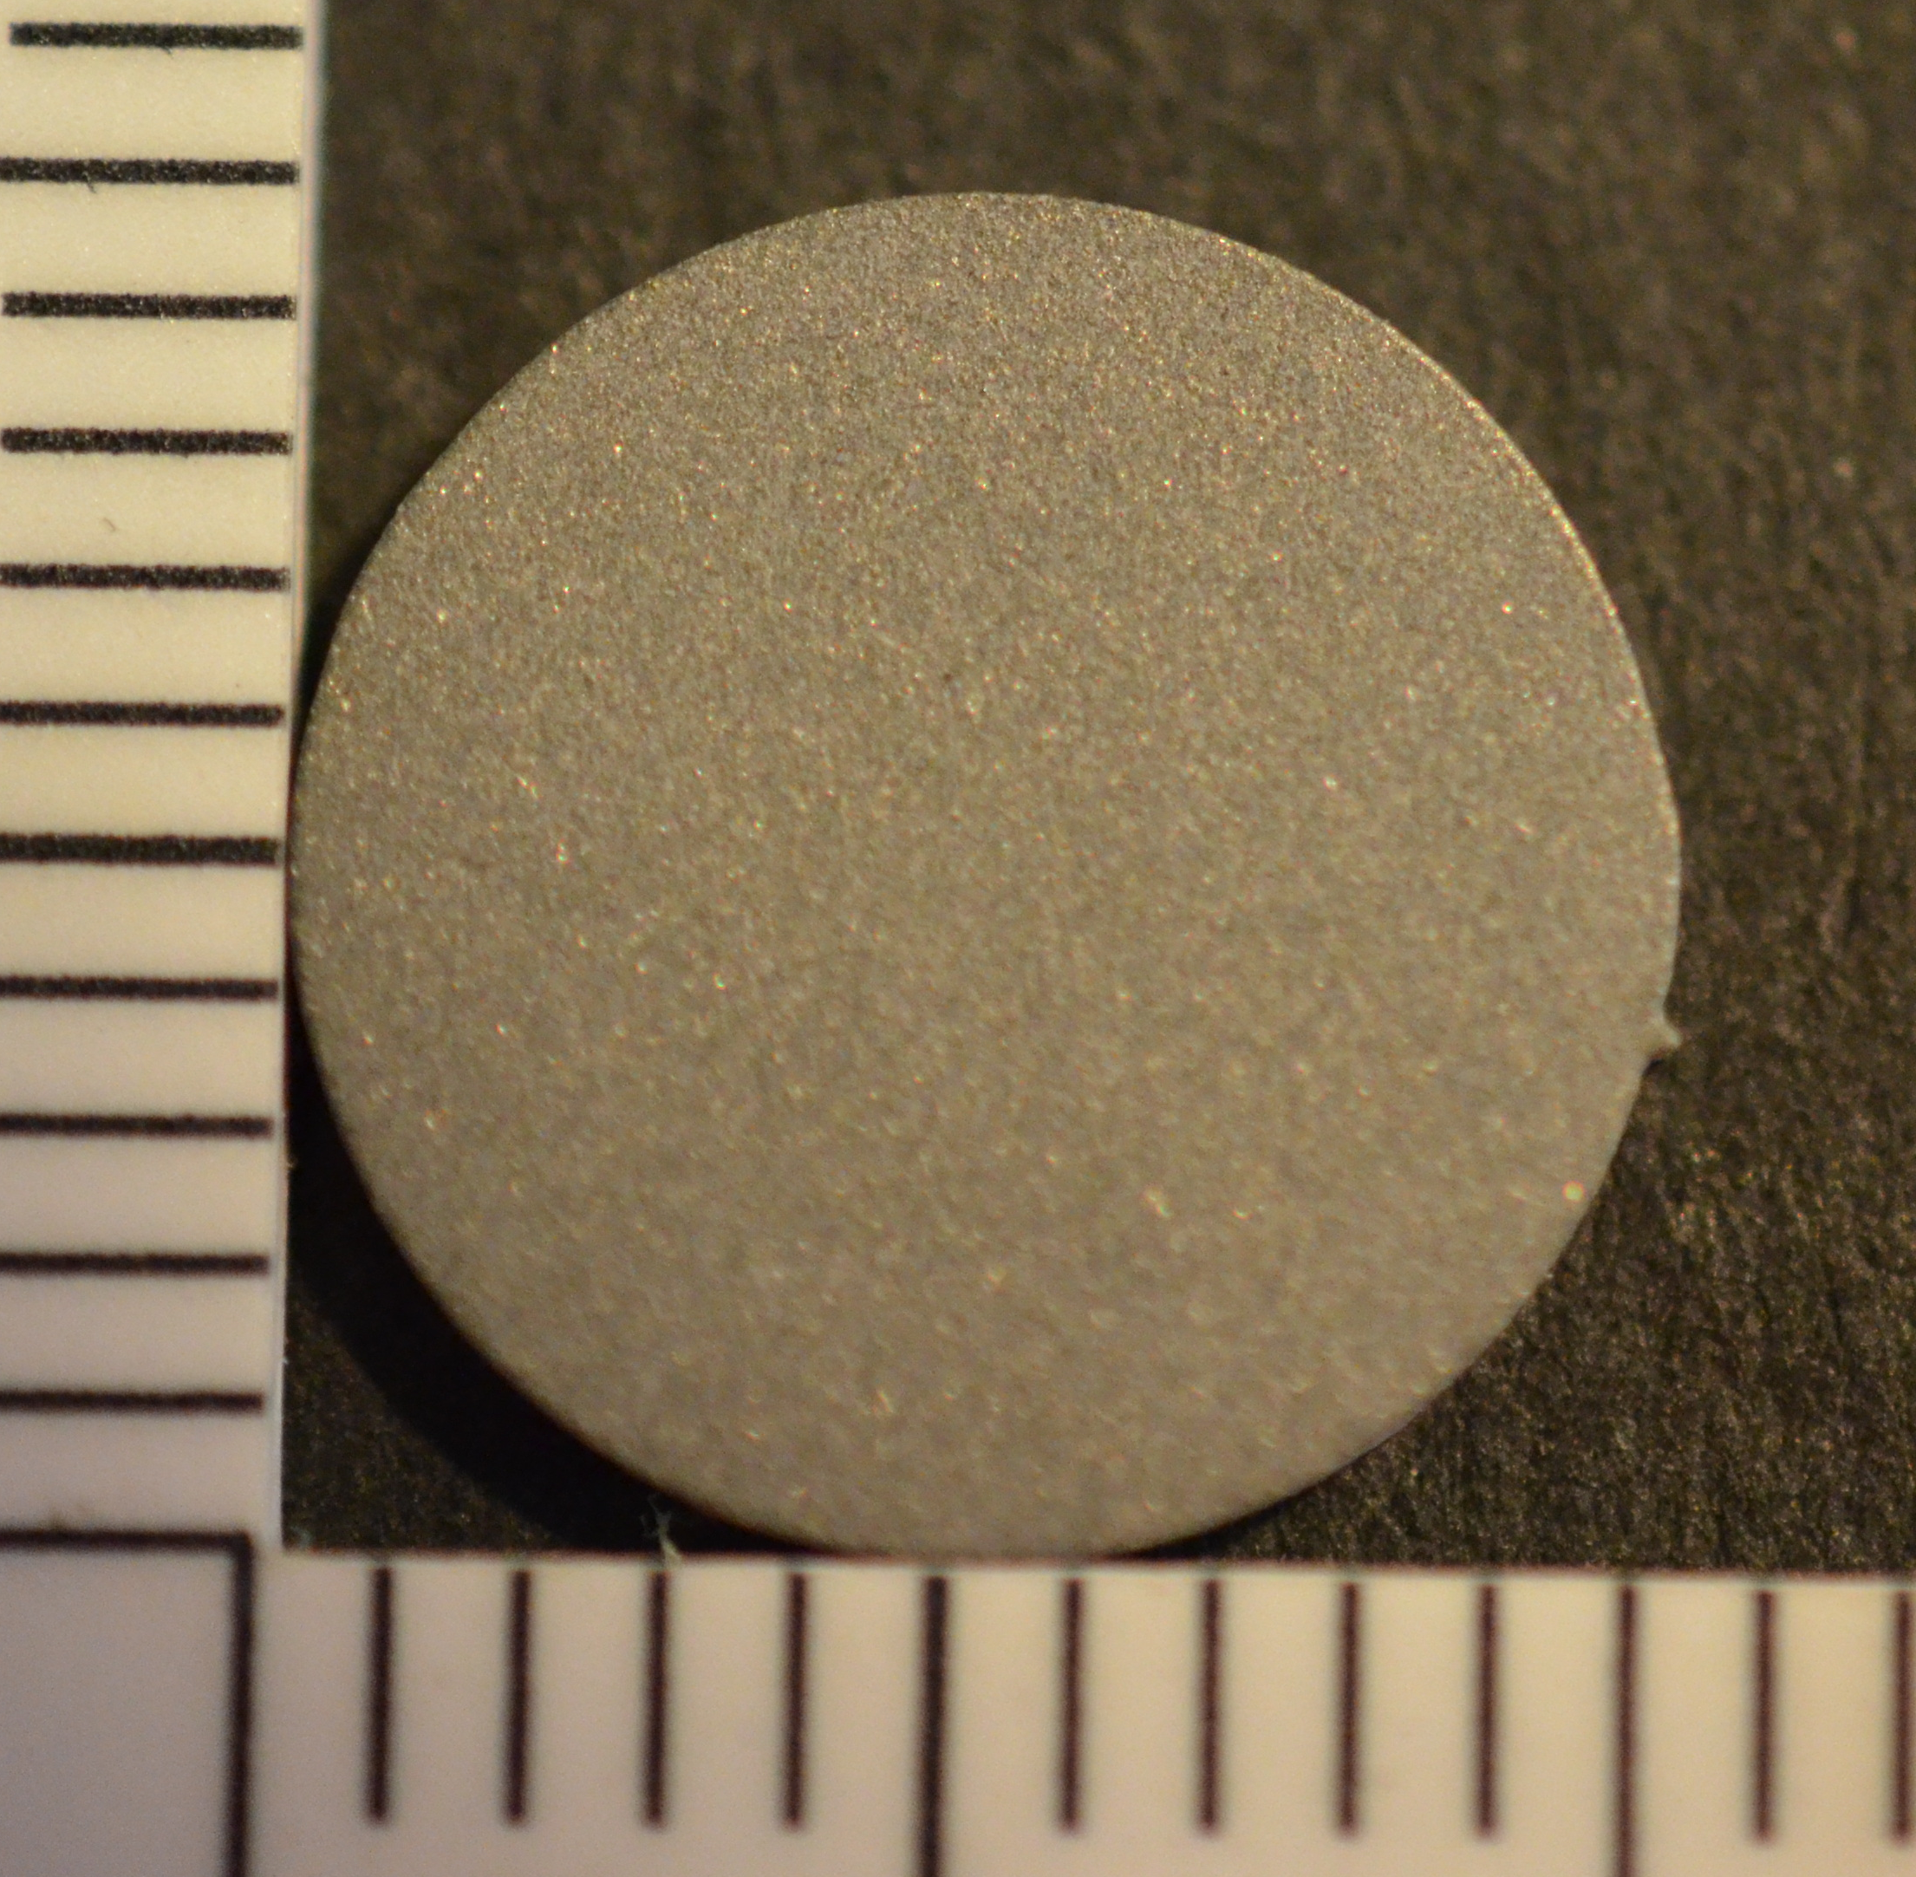
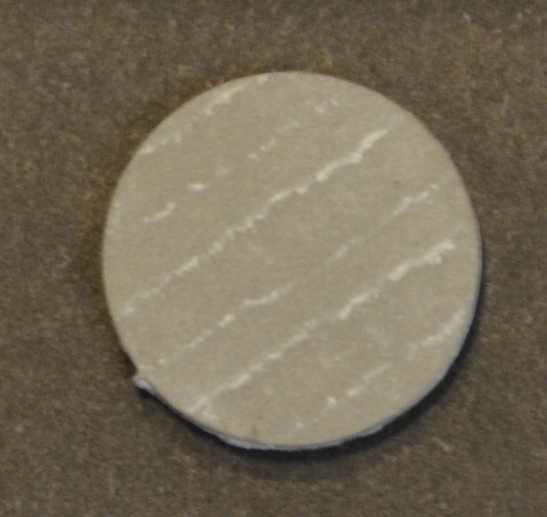
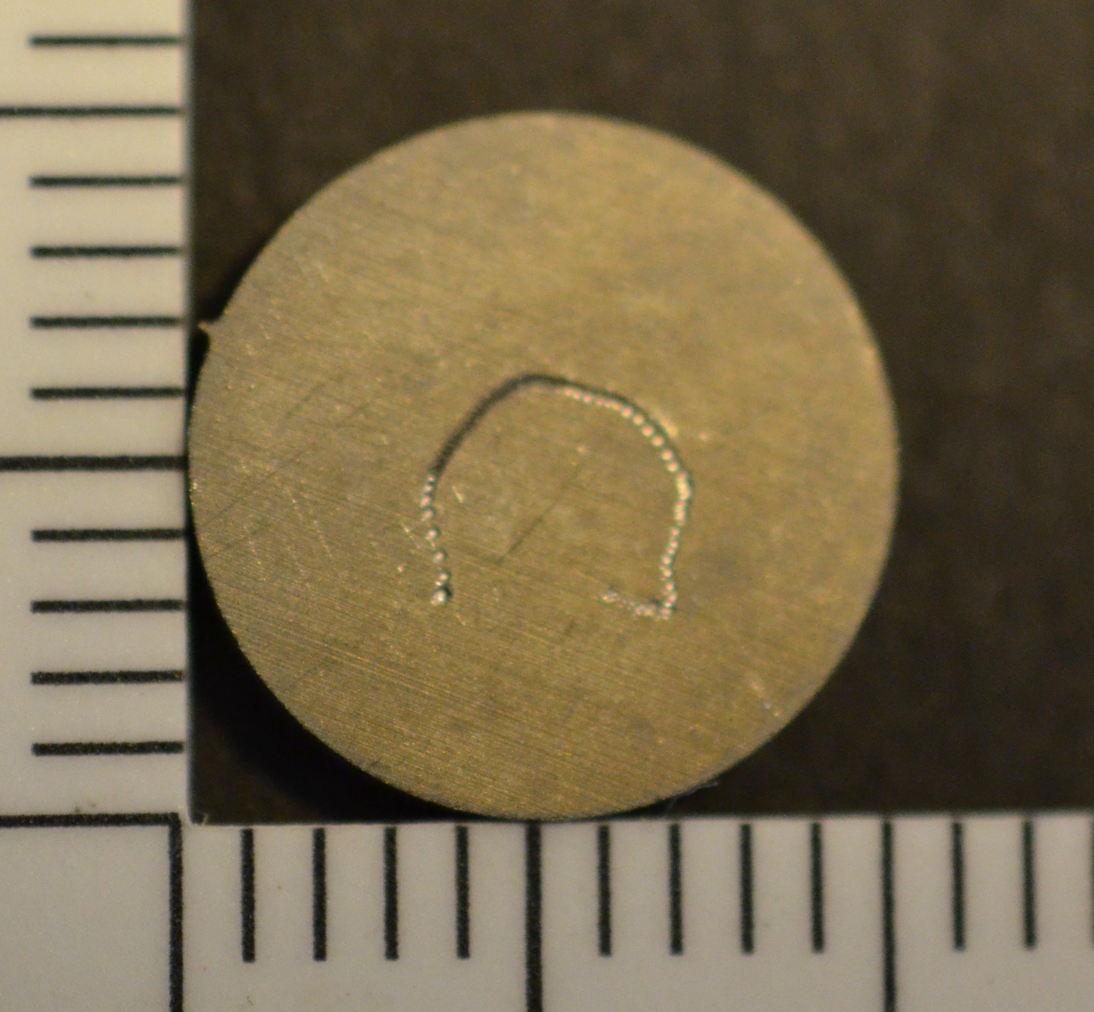
Wettability of a Novel Biofilm-Resistant Surface Modification Process
for Metallic Implants
Caroline Bales¹, Sarah Helms¹, John D. DesJardins, PhD¹
¹Clemson University, Clemson, SC, USA
Introduction
Results
The accumulation of proteins and bacteria on implant surfaces is a critical concern in the biomedical field, especially with respect to the potential of biofilm formation on implant surfaces. Material surface wettability is often used as a predictor of surface interactions between a material and the surrounding environment and potential colonization of specific bacterial strains. Surface roughness has also been shown to have a strong relationship with biofilm formation, as rougher surfaces tend to have a stronger affinity to harbor bacterial colonies. The modification of implant surfaces to impart a biofilm resistant layer can come at the expense of increasing surface roughness, however, and it is therefore important to determine how the variables of wettability and roughness are affected by any new surface coating technologies. This study aims to investigate the impact of surface roughness and wettability on the formation of biofilms on metallic implants.
A
B
Materials and Methods
C
D
Figure 7. Contact angles of A) TB sample with DI water, B) TP9CV sample with DI water, C) TB sample with diiodomethane, and D) TP9CV sample with diiodomethane.
13 different categories of samples were tested, all with a different combination of surface modifications. Most samples, except for those labeled blank (B), had a CoBlasted (C) surface. CoBlast™ impregnates the surface with alumina (A) at either 50 μm grit (5) or 90 μm grit (9), and some CoBlasted surfaces have polytetrafluoroethylene (P) as well. Some also have either chitosan (X) or both chitosan and vancomycin (V) on the surface, added via a plasma deposition process called BioDep™.
N=65 titanium alloy samples (n=5 for 13 sample modification types as described above and shown in Figures 2-5) were analyzed for surface roughness and wettability.
Following cleaning in ethanol, roughness testing (for measures of Ra, Rq, Rt and Rz) was performed using a Wyko NT-2000 optical profilometer (28.7x magnification, FOV of 164x215 μm) at 5 different locations on the surface of each specimen.
Contact angle analysis was performed using a KRUSS EasyDrop instrument. The KRUSS Drop Shape Analysis software was used to analyze each of the 2 μL drops of water and each of the 1 μL drops of diiodomethane to determine their contact angle with the surface.
Statistical differences between groups were determined using ANOVA.
Discussion and Conclusion
Figure 3. Graphical representation of the average contact angle value, found using deionized water, for each of the different sample types, where N=10 sample locations were tested per type (2 locations on 5 specimens).
Figure 4. Graphical representation of the average roughness value for each of the different sample types, where N=25 sample locations were tested per type (5 locations on 5 specimens).
It was shown that changing the coating of a material can change the surface topography and the wettability of the surface, which can be beneficial for different applications. The results from this work show that the CoBlast and BioDep™ processes significantly affect both wettability and roughness, and that the benefits and potential drawbacks of each must be considered when assessing their potential for biofilm resistance. PTFE-coated samples would be best used when wanting to prevent a hydrophobic substance from binding to the material, while the alumina-coated or blank samples would be best used to prevent a hydrophilic substance from binding. Nonpolar liquid wettability was also assessed to better mimic in-vivo conditions and to determine surface energy to be able to make better conclusions about the relationship between surface roughness and wettability. As expected, the most hydrophobic samples also had the lowest surface energy. Having these values allows for the determination of the best surface to use in different environments, based on the bacteria present.
Future work will involve testing the wettability and surface energy of protein-fouled surfaces to compare to the results shown here. These experiments will allow for a better understanding of the performance of these materials in an environment in which proteins are already present, for a more direct application to use in the human body.
Figure 1. A cartoon detailing the CoBlast™ process¹. First, the oxide layer is removed, as this layer presents a barrier to coating adhesion. Then,aAaza the metallic surface is roughened to create an ideal surface for coating adhesion. Finally, the coating is deposited onto the sample¹.
Figure 5. Graphical representation of the average contact angle value, found using diiodomethane, for each of the different sample types, where N=10 sample locations were tested per type (2 locations on 5 specimens).
Figure 6. Graphical representation of the surface energy found for each of the different sample types, where N=10 sample locations were tested per type (2 locations on 5 specimens).
References
As seen in Figure 4 summarizing the roughness results, significant roughening was observed between surface blanks and all surface modification techniques, especially the CoBlasted 90 μm grit treatments. As expected, wettability (shown in Figures 3 and 5) was significantly affected by PTFE modifications and also by the introduction of
A
B
C
D
chitosan and vancomycin. Surface energy, shown in Figure 6, was also significantly affected by the PTFE modifications.
1. ENBIO. “CoBlast.” N.p., n.d. Web. 4 Oct. 2017.
Figure 2. Zoomed-in views of a) the coated side of a TBX sample, b) the coated side of a TP9CX sample, c) the coated side of a TP5C sample, and d) an uncoated sample.. There is a clear difference in the appearance of the surface between the blank and the CoBlasted samples, as well as between the two CoBlasted samples.
Acknowledgements
This work is funded through the Department of Defense, CDMRP, Grant # W81XWH-14-1-0438. Data was collected in the SC BioCRAFT Bioengineering and Bioimaging Core Facility, which is supported by NIGMS of the NIH under award number 5P20GM103444-07.
Presented at the Biomedical Engineering Society Annual Conference 2017
Phoenix, AZ, Biomechanics of Biomaterials, P-TH-122
Corresponding Author: Dr. John DesJardins, Clemson University
301 Rhodes Building, Clemson, SC 29634, jdesjar@clemson.edu

